Slide 1

ESG AND FINANCIAL PERFORMANCE ANALYSIS
Leveraging ESG Data For Growth And Sustainability
This Photo by Unknown Author is licensed under CC BY-ND

Slide 2
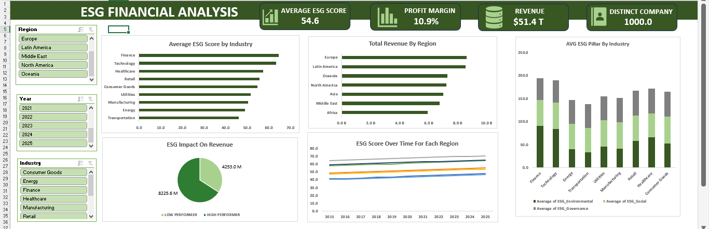
ESG FINANCIAL ANALYSIS DASHBOARD

Slide 3
CONTENT
Introduction
Objective
Problem Statement
Data Description
Data Preparation
Analysis And Findings
Policy And Strategy Recommendation
Conclusion

Slide 4
INTRODUCTION
The global business landscape is increasingly shaped by Environmental, Social and Governance (ESG) factors, which affect company performance. With growing stakeholder demand for sustainability, ESG financial analysis has been critical. It highlights risks and opportunities tied to climate change, social equity and equity governance.
This analysis would explore how ESG impacts financial outcomes, including profitability and dividend stability, while revealing variations across sectors like energy and finance, and regions such as the EU and Asia. Understanding these dynamics is essential for investors, policy makers, and businesses aiming for sustainable growth

Slide 5
OBJECTIVES
Identify high and low performing company from an ESG perspective
Investigate which ESG pillars (Environmental, Social, Governance) most strongly correlate with financial success
Recognizing industry or regional patterns in ESG scores and performance metrics

Slide 6
PROBLEM STATEMENT
The company exhibits a moderate ESG score of 54.6, lagging behind top performing industries like finance and technology scoring 70, which correlates with a low profit margin of 10.9% compared to high to ESG performers 16.7%. Revenue distribution is heavily skewed towards Europe with $8.6B, minimal contributions from regions like Africa and the Middle East <$7B each, indicating market penetration issues.

Slide 7
DATA DESCRIPTION
Company ID
Company Name
Industry
Region
Year
Revenue (USD M)
Profit Margin (%)
Market Cap (USD M)
Growth Rate (10%)
ESG Overall (0-100)
ESG Environmental (0-100)
ESG Social (0-100)
ESG Governance (0-100)
Carbon Emission (tCO2)
Water Usage (Liters)
Energy Consumption (MWH)
ESG Group
Company Count

Slide 8
DATA PREPARATION
Cleaned and calculated important columns in excel for accuracy and relevance for analysis. Key steps include:
Grouped ESG score into high performer >75 and low performer <75
Calculated a column to count the amount of companies

Slide 9
ANALYSIS AND FINDINGS
KEY PERFORMANCE INDICATORS (KPIs):
Average ESG Score – 54.6 (shows a moderate ESG score across all industries)
Profit Margin – 10.9% (shows the average profit margin across all industries)
Revenue - $54.1T (shows revenue gained across all regions and for all industries)
Distinct Company Count – (shows the total number of companies in analysis)

Slide 10
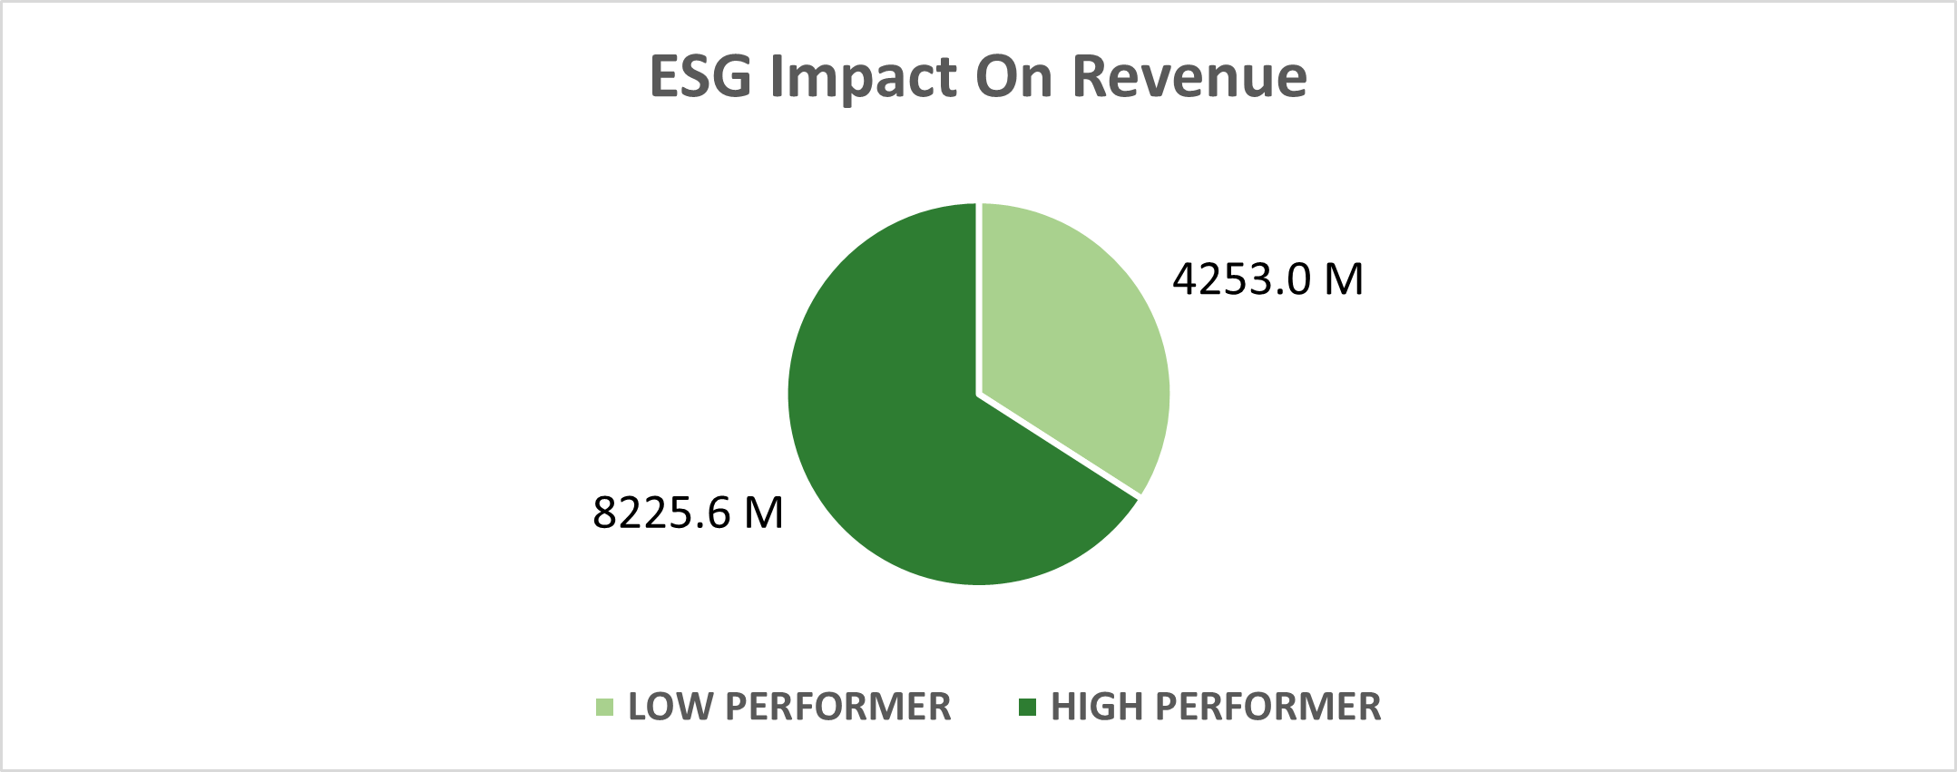
ESG IMPACT ON REVENUE
High ESG performers contributes 65.7% of revenue ($8225.6M).
Low ESG performers ($4253.0M), indicating risk from regulatory and consumer shifts

Slide 11
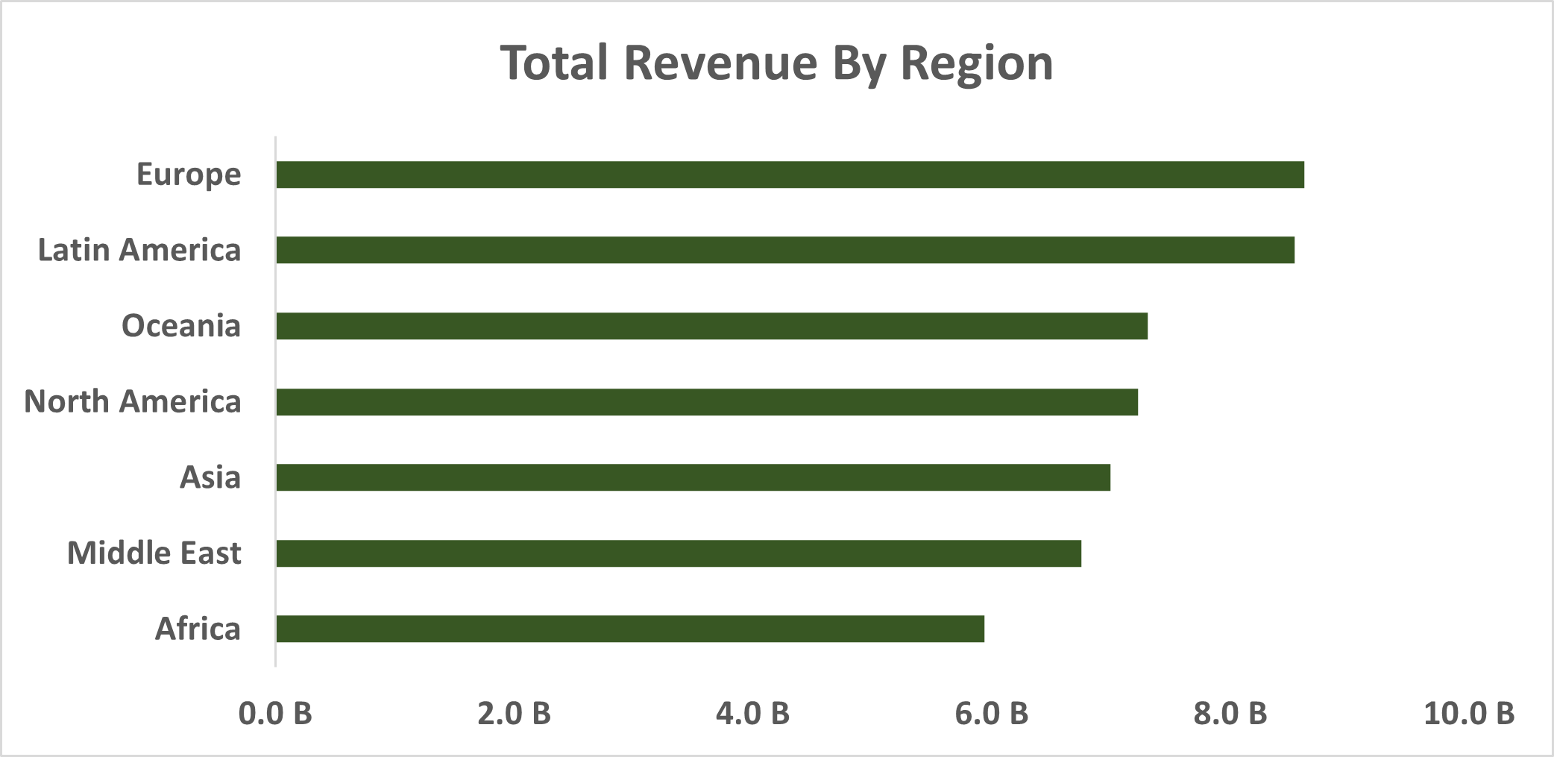
REGIONAL DISPARSITIES
Europe leads in revenue with close to $8.6B.
Middle east and Africa lags with <$7B in revenue.
This means industries based in EU and Latin American regions are ESG compliant and could be great for investing

Slide 12
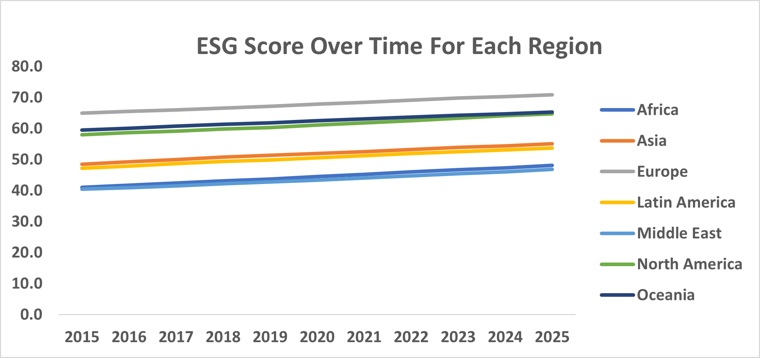
ESG TRENDS
Gradual increase in ESG score across all regions from 2015 – 2025.
Europe and North America leads.

Slide 13
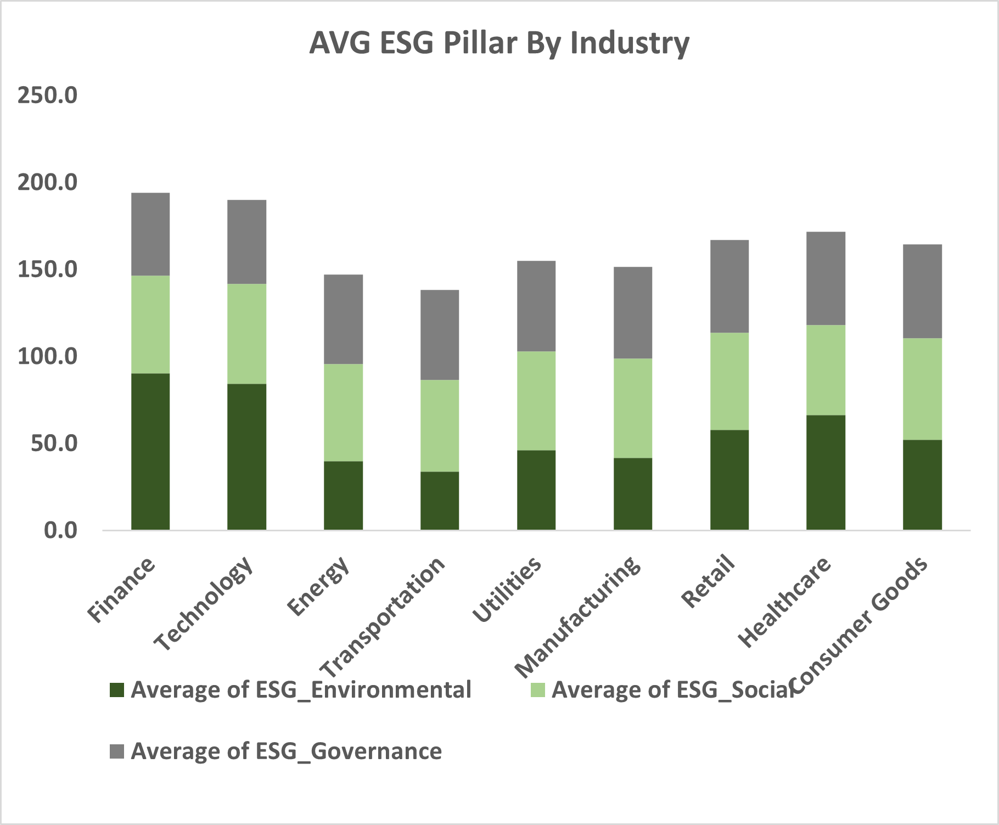
ESG METRICS FOR INDUSTRIES
Finance, healthcare and technology are leading with environmental ESG scores. This indicates strong environmental practices been upheld.
On the other hand energy and transportation industries need to do better with the environmental score.

Slide 14
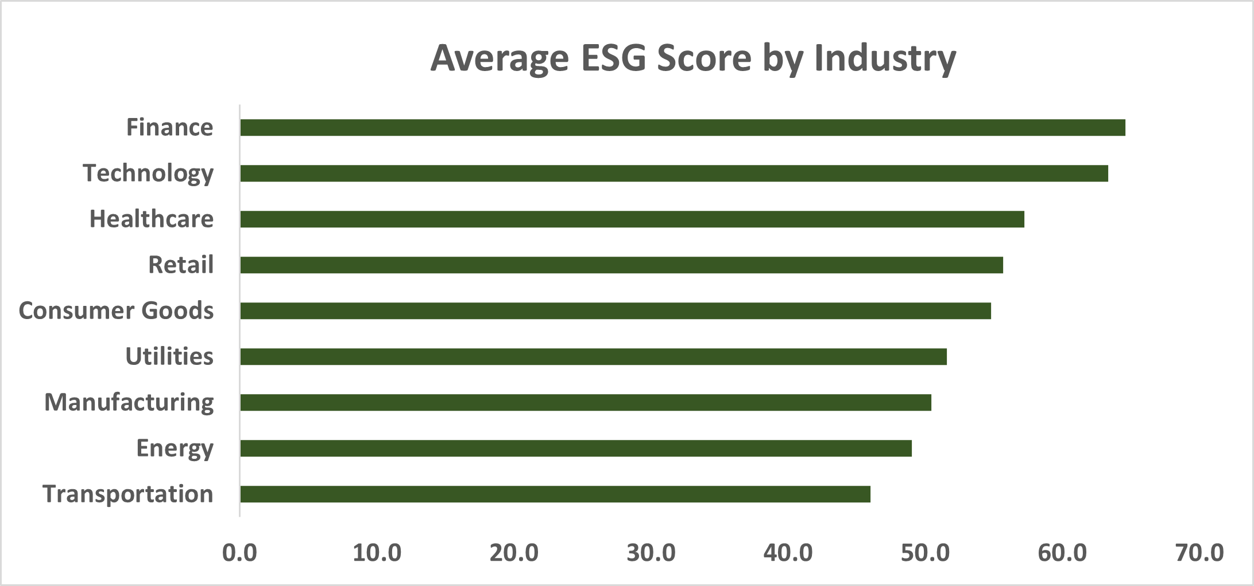
AVERAGE ESG SCORE FOR ALL INDUSTRIES
With higher ESG score in finance, technology and health care industries, investing in the businesses would yield profitable returns.
Industries such as energy and transportation would generate little revenue and would be bsd for business.

Slide 15
POLICY AND STRATEGY RECOMMENDATION
Environmental Pillar: Energy and manufacturing needs carbon emission reduced, renewable energy adoption.
Social Pillar: Consumer goods and retail needs better labor practices.
Regional Focus: Latin America and Asia needs localized ESG initiatives.
Invest In Rising ESG Trend: Target finance and technology – high ESG scores
Invest In Emerging Markets: Asia and Latin America with improving ESG scores
Support Low ESG Performers: Capitalize on growing demands for sustainability

Slide 16
CONCLUSION
Key insights shows show strong revenue contribution, industry specific ESG performance and a positive correlation between ESG score and revenue growth over time.
Leverage on this findings to drive sustainable financial strategies.
Thank you!

